Slide 1
ESCAP/WMO Typhoon Committee 18TH INTEGRATED WORKSHOP/ 4TH TRCG FORUM
Satellite Remote Sensing-based Flood Disaster Monitoring affected by Typhoon SON-TINH: Nongbok District of Khammouane Province, Lao PDR
Virasith Phomsouvanh, Deputy Director, Natural Resources and Environment Research Institute
Manisakhone Chittaphong, Researcher in Climate Change, Modeling Division, MONRE
Phayvone Sengphone, RS Specialist, Remote Sensing and Mapping Division
Ministry of Natural Resources and Environment
Natural Resources and Environment Research Institute
Bangkok, 28 November -01 December 2023

Slide 2
Historical Activities of Remote Sensing and Mapping Division
(RSMD)
NRERI-MONRE
of Lao PDR
+
NRERI-MONRE
of Lao PDR
JAXA/AIT/ Mini-Project:
Flood Monitoring using RS&GIS 2006-2008
Flooding in 2008, Vientiane Capital of Lao PDR
NRERI-MONRE
of Lao PDR
Field survey surrounded the flood damage area in Vientiane Capital of Laos on 11-15 August 2008.

Slide 3
Natural Disaster Risk Assessment at Nateuy Village, Namtha District,
Laungnamtha province
2. Landslide Risk and Soil Erosion in the Project’s site
1. Flood Risk Potential in the Project’s site
Soil erosion (a) and Landslide Risk (b)
3. Drought Risk in the Project’s site
Averaged-Rainfall Amount happened between 01-22 July 201
Flood simulation affected by climate change (Precipitation)

Slide 4
Flood Monitoring
Flood monitoring, Three districts of Savannakhet Provinces, affected by climate change impact:
Champhone district
Xonboury district
Songkhone district

Slide 5
Monitoring MP2.5 Air Pollution
var AOD = ee.ImageCollection("MO DIS/006/MCD19A2_GRA NULES");

Slide 6
NRERI-FAO Cooperation
Spatio-temporal dynamics of air pollution and the delineation of hotspots in the Lao People's Democratic Republic
Yearly means for the period 2015–2021 for a) aerosol optical depth (AOD) and b) ultraviolet aerosol index (UVAI) and average column amounts of c) nitrogen dioxide (molec/cm2 ); d) ozone (DU) and e) sulphur dioxide (DU
Images taken from the field data collection. a) Interview with villagers/famers to assess the contribution of farming to air pollution in Parkou district in Luangprabang. b) Field location survey and data collection in Luangprabang. c) Discussion with governmental officials to assess the contribution of anthropogenic activity to air pollution in Luangprabang. c) Interview with villagers to assess the contribution of farming practices to air pollution Chomphet district, Luangprabang
Five provinces with highest pollution indicators based on provincial means of each pollution indicator averaged over study period (left: geographic locations; right: provinces ranked)

Slide 7
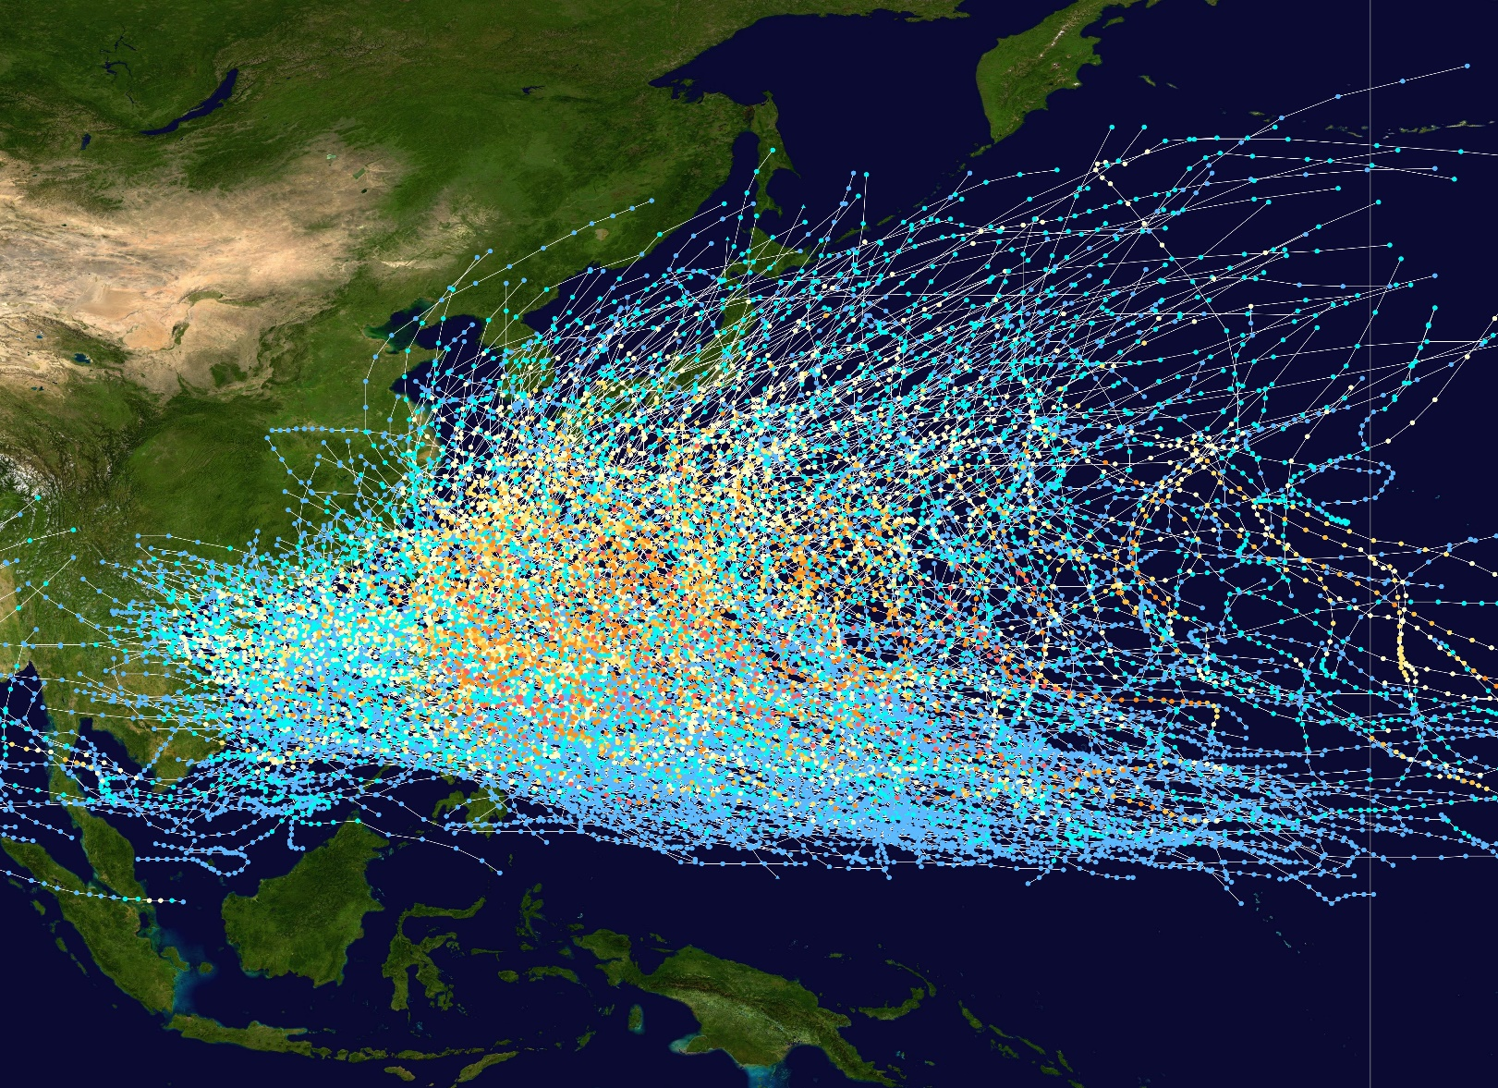
History of Asia-Pacific Typhoon (1980-2005)
Between 1985 and 2005, there were a total of 484 typhoons and 79 super typhoons in the Southeast Asia region. The deadliest typhoon during this period was Typhoon Megi, which killed over 8,000 people in the Philippines in 1998.
The most active year for typhoons in the Southeast Asia region during this period was 1993, with 28 typhoons. The least active year was 1988, with 16 typhoons.
The average number of typhoons per year in the Southeast Asia region during this period was 22.2. The average number of super typhoons per year was 3.9.
Saffir–Simpson scale
Storm Type
Source: https://commons.wikimedia.org/wiki/File:Pacific_typhoon_tracks_1980-2005.jpg

Slide 8
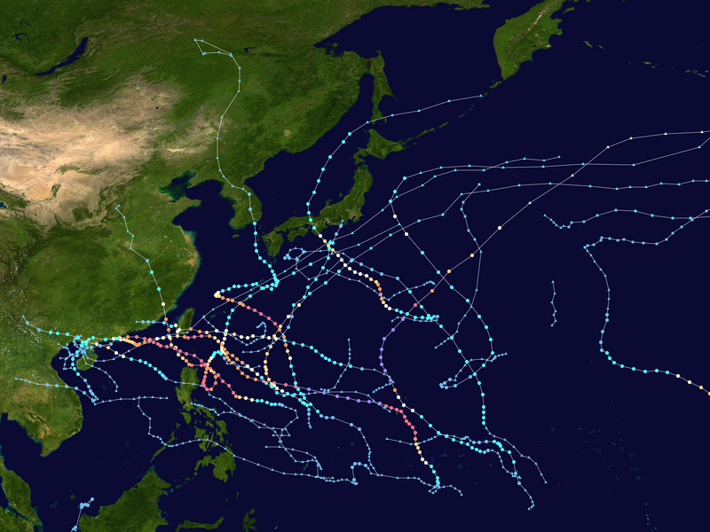
Asia-Pacific Typhoon Season in 2023
The 2023 Pacific typhoon season was an active season with 28 tropical depressions, 16 tropical storms, and 10 typhoons. Four of these typhoons were super typhoons. The season also caused 191 fatalities and $18.5 billion in damage.
Saffir–Simpson scale
Storm Type
Source: https://en.wikipedia.org/wiki/File:2023_Pacific_typhoon_season_summary.png

Slide 9
Background
Son-Tinh Tropical Storm
Dated 18-20 July 2018
55 districts of 13
Provinces are affected
Source: http://www.gdacs.org/Cyclones/report.aspx?eventt ype=TC&eventid=1000469&episodeid=10
Bebinca Tropical Storm
dated 16-18 August 2018
116 districts and 2,400
villages are affected
Source: http://www.gdacs.org/Cyclones/report.aspx?eventt ype=TC&eventid=1000485&episodeid=9

Slide 10
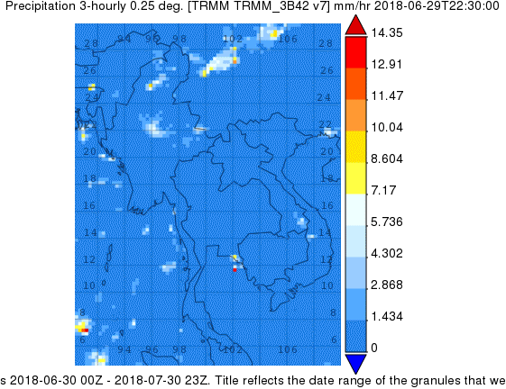
Son-Tinh Observation (01-30 July 2018)
Satellite Tropical Rainfall Measuring Mission (TRMM)

Slide 11
Summary of Son-Tinh and Bebinca’s Damages and Losses in Lao PDR
Total damages are 147 million US dollars (1,253.10 billion kip) and the total loss is 224.5 million US dollars (1,914.02 billion kip).
❑ After the storm calmed down, it was possible to estimate and summarize the damage: there are 2,382 villages and 126,736 houses and there are a total of 616,145 people in all 18 provinces.
❑ From the results of the damage and loss caused by the two dust storms, the total value of damage and loss can be estimated at 3,166.99 billion kip or about 371.5 million US dollars.
Source: https://reliefweb.int/sites/reliefweb.int/files/resources/PDNA_Lao_ PDR_Report_Final_Lao.pdf

Slide 12
Case Study
According to recent statistics, Lao PDR has been damaged by several large subtropical dust storms;
Typhoon Ketsana in 2009, and Typhoon Haima in 2011 caused damage and losses worth 58 million dollars and 159 million dollars, respectively.
In addition, in 2013, there were severe floods that occurred in all parts of Laos; Because of the influence of various dust storms that have moved into Lao PDR, such as Typhoon Jebi and Typhoon Monghut, Typhoon Wutip and tropical depression
During the period of 35 years, the calculated damage value is more
than 270 million dollars.
Source: https://reliefweb.int/disaster/fl-2013-000101-lao

Slide 13
Nongbok District, Khammouane Province
Source: Comprehensive environnemental management plan in Khammouane Province
Source: OpenstreetMap

Slide 14
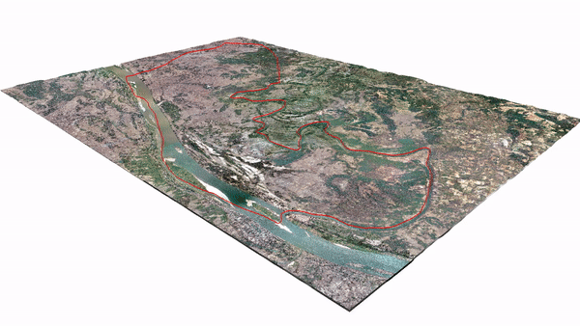
Moniroing Typhoon Son- Tinh affected to Laos from climate change impact
movement of Typhoon Son-Tinh (Tropical Storm Son-Tinh) by TRMM using Tropical Rainfall Measuring Mission
(TRMM) between 01-30
July 2018.
Flood simulation in Nongbok District with Typhoon Son-Tinh, Khammouane Province

Slide 15
Analytical and processing procedures
Fill &
Reclassify
Processing Image
StatisticalAna lysis
Flood Map
Processing
Image
Community Dataset: Road, Villages,
Socio-Economic

Slide 16
Results
From the analysis of Sentinel-1 satellite images, it was found that: Sentinel 1 satellite image (July 30, 2018) is a day with a lot of water compared to July 18, 22 and 24, 2018, with a flooded area of 148 km2 (14800 ha)/313 km2 of Nong Buk area.
Flood severity is divided into 03 levels: (1) Level 01: 23 villages; (2) Level
02: 11 houses and (3) Level 03: 02 houses.
Socio-economic areas were damaged: (1) agriculture 100,238,700,000 kip;
(2) Energy 720,612,000 kip; (3) Public health 900,000,000 kip; (4) Public works and transportation 60,840,720,000 kip and (5) Private investment 15,100,000 dollars and 80,000,000 baht.

Slide 17
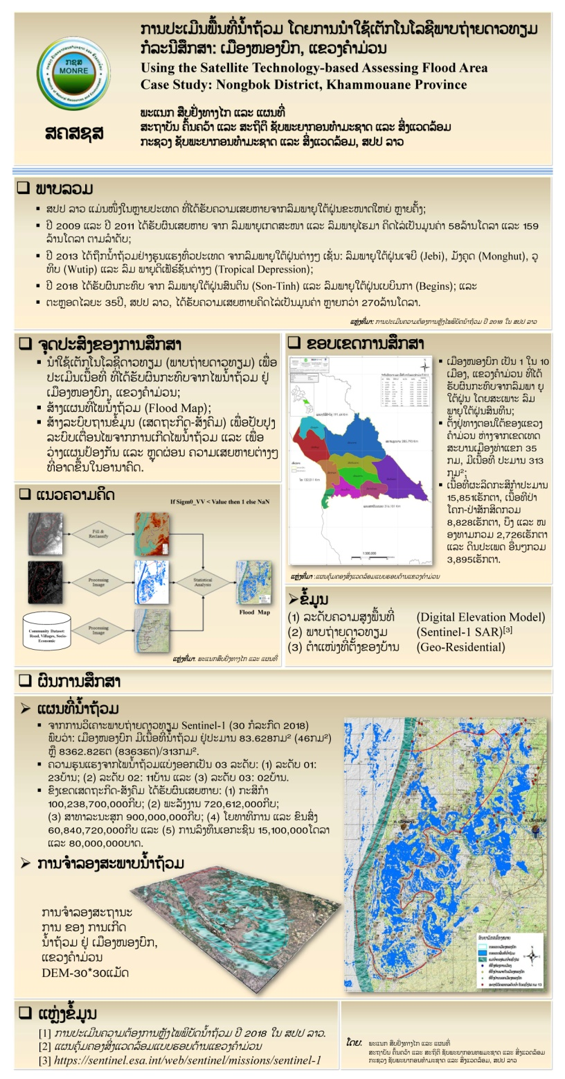
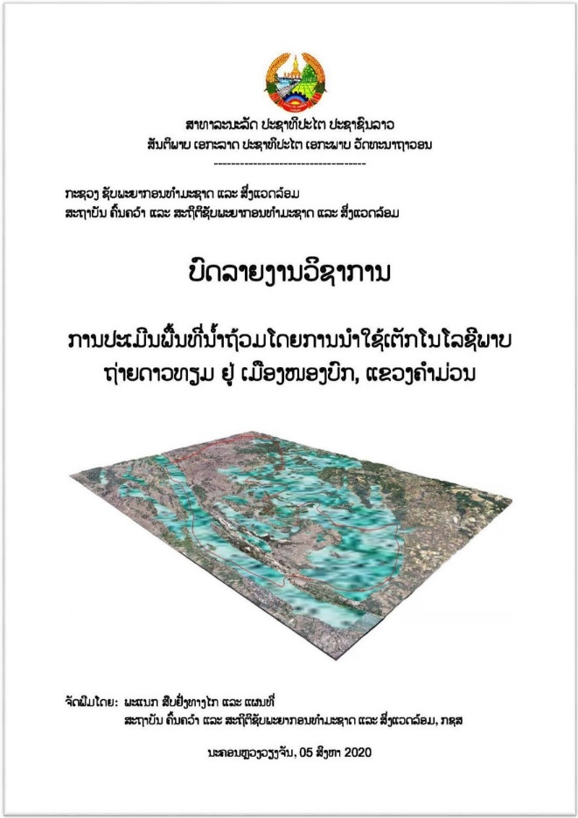

Slide 18
Conclusions of Typhoon Monitoring in Lao PDR
Challenges:
Limited spatial and temporal coverage of observation networks
Lack of real-time data processing and analysis capabilities
Inadequate communication and dissemination mechanisms
Limited public awareness and understanding of typhoon risks
Limited financial resources
Limited capacity to utilize satellite remote sensing technology
Inadequate ground-truthing data for satellite imagery
Limited integration of satellite data into operational forecasting models
Recommendations:
Expanding the observation network
Investing in real-time data processing and analysis capabilities
Improving communication and dissemination mechanisms
Raising public awareness and understanding of typhoon risks
Increasing financial resources for typhoon monitoring and early warning
Building capacity to utilize satellite remote sensing technology
Collecting ground-truthing data for satellite imagery
Here are some additional challenges that Lao PDR faces in using satellite remote sensing technology for typhoon monitoring and early warning:
The high cost of satellite imagery: Satellite imagery can be expensive, which can limit Lao PDR's ability to purchase and use this data.
The need for specialized expertise: The analysis and interpretation of satellite imagery requires specialized expertise, which can be difficult to find and train in Lao PDR.
The challenges of cloud cover: Cloud cover can obscure satellite imagery, making it difficult to track typhoons.

Slide 19
Future Cooperation
Ministry of Natural Resources and Environment
Natural Resources and Environment Research Institute
Remote Sensing and Mapping Division

